Slide 1

307401 Big Data and Data Warehouses
Introduction to Big Data

Slide 2
Introduction to Big Data

Slide 3
Content
Welcome to the world of Big Data!
Understanding Big Data: Definition and significance.
Exploring the 5 V’s of Big Data: Volume, Velocity, Variety, Veracity, and Value.

Slide 4
Big Data in a Nutshell
The evolution of technology over the past few decades has dramatically transformed the way we generate, store, and process data.
In the early days of computing, data was limited to what could be managed by traditional relational databases. However, the advent of the internet in the 1990s led to an exponential increase in data production, fueled by the rise of e-commerce, social media, and the digitization of countless industries.
As more devices connected to the internet, including smartphones, sensors, and IoT devices, the volume of data surged to unprecedented levels.
This data explosion highlighted the limitations of traditional data management and processing tools, necessitating the development of new technologies capable of handling the scale and complexity of modern data.
To address these challenges, the early 2000s saw the introduction of groundbreaking technologies like Google File System (GFS) and MapReduce, which laid the foundation for scalable data storage and parallel processing.
These innovations led to the creation of Apache Hadoop, an open-source framework that brought the power of GFS and MapReduce to the wider community.
Alongside Hadoop, a variety of new tools and frameworks emerged, such as Apache Spark for in-memory processing, Apache Kafka for real-time data streaming, and NoSQL databases like MongoDB and Cassandra for flexible, schema-less data storage.
These technologies have collectively formed the backbone of the Big Data ecosystem, enabling organizations to efficiently process and analyze vast datasets, uncover insights, and drive data-driven decision-making in ways that were previously unimaginable.

Slide 5
البيانات الضخمة، باختصار
أدى تطور التكنولوجيا على مدى العقود القليلة الماضية إلى تغيير جذري في الطريقة التي ننتج بها البيانات، ونخزنها، ونعالجها.
في الأيام الأولى للحوسبة، كانت البيانات مقتصرة على ما يمكن إدارته بواسطة قواعد البيانات العلائقية التقليدية.
الا ان ظهور الإنترنت في التسعينيات أدى إلى زيادة هائلة في إنتاج البيانات، وغذا ذلك ازدياد استخدام التجارة الإلكترونية، ووسائل التواصل الاجتماعي، ورقمنة عدد لا يحصى من الخدمات والصناعات.
ومع تزايد عدد الأجهزة المتصلة بالإنترنت، بما في ذلك الهواتف الذكية وأجهزة الاستشعار وأجهزة إنترنت الأشياء، ارتفع حجم البيانات إلى مستويات غير مسبوقة.
سلط هذا الازدياد الكبير في حجم البيانات الضوء على الأدوات التقليدية المستخدمة في إدارة البيانات ومعالجتها، مما استلزم تطوير تقنيات جديدة قادرة على التعامل مع حجم البيانات الحديثة وتعقيدها.
ولمواجهة هذه التحديات، شهد أوائل العقد الأول من القرن الحادي والعشرين إدخال تقنيات رائدة مثل نظام ملفات Google (GFS) وMapReduce، والتي أرست الأساس لتخزين البيانات القابلة للتوسع وللمعالجة المتوازية.
أدت هذه الابتكارات إلى إنشاء منظومة Apache Hadoop، وهي عبارة عن إطار عمل مفتوح المصدر جلب قوة الـ GFS وMapReduce إلى المجتمع الأوسع.
إلى جانب Hadoop، ظهرت مجموعة متنوعة من الأدوات والأطر الجديدة، مثل Apache Spark لمعالجة البيانات بشكل سريع داخل الذاكرة الرئيسية للأجهزة، وApache Kafka لإدارة تدفق البيانات في الوقت الفعلي، وقواعد بيانات NoSQL مثل MongoDB وCassandra والتي تستخدم البيانات المرنة بدون الهياكل المحددة.
لقد شكلت هذه التقنيات مجتمعة العمود الفقري للنظام البيئي للبيانات الضخمة، مما مكن المؤسسات من معالجة مجموعات البيانات الضخمة وتحليلها بكفاءة، والكشف عن المعلومات الخفية داخل البيانات، ودفع عملية صنع القرار المستندة إلى البيانات بطرق لم يكن من الممكن تصورها في السابق.

Slide 6

Apache Foundation
The Apache Software Foundation (ASF) is a non-profit organization established in 1999 to support a variety of open-source software projects. Known for overseeing well-known projects such as the Apache HTTP Server and Apache Hadoop, the ASF provides resources, infrastructure, and a collaborative framework for open-source development, fostering innovation and community-driven progress.
The Apache License 2.0 is a permissive open-source license that allows for free redistribution, modification, and use of software, both commercially and privately. It includes provisions for a patent grant, ensuring contributors cannot sue users for patent infringement, and requires that modifications be documented and the original license included in distributions. This license is favored for its flexibility and minimal restrictions, making it a popular choice for many open-source projects.
Apache Software Foundation (ASF) هي منظمة غير ربحية تأسست في عام 1999 لدعم مجموعة متنوعة من مشاريع البرمجيات مفتوحة المصدر. تشتهر المؤسسة بالإشراف على مشاريع بارزة مثل خادم Apache HTTP و Apache Hadoop، وتوفر الموارد والبنية التحتية وإطار العمل التعاوني لتطوير البرمجيات مفتوحة المصدر، مما يعزز الابتكار والتقدم القائم على المجتمع.
تمثل رخصة برمجيات Apache 2.0 رخصة مفتوحة المصدر مرنة تسمح بإعادة التوزيع والتعديل والاستخدام الحر للبرمجيات، سواء لأغراض تجارية أو للأغراض الخاصة.
تتضمن الرخصة أحكامًا لمنح براءات الاختراع، مما يضمن عدم مقاضاة المساهمين للمستخدمين بتهمة انتهاك براءات الاختراع، وتتطلب توثيق التعديلات وإدراج الرخصة الأصلية في التوزيعات.
تحظى هذه الرخصة بشعبية كبيرة بفضل مرونتها وقيودها القليلة، مما يجعلها خيارًا مفضلاً للعديد من مشاريع البرمجيات مفتوحة المصدر.

Slide 7
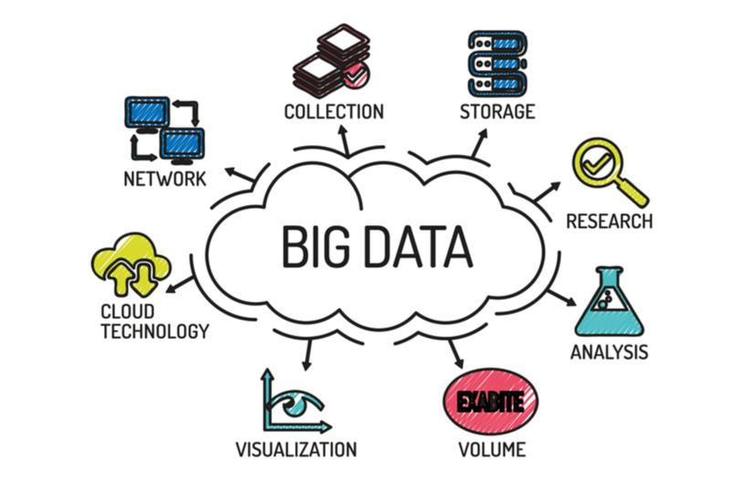
What is Big Data?
Big Data refers to datasets that are so large or complex that traditional data processing applications are inadequate.
It is not a single technique or a tool, rather it has become a complete subject, which involves various tools, techniques and frameworks.
Big Data requires advanced technologies to efficiently process and analyze.
Big Data enables organizations to gain insights and make data-driven decisions.

Slide 8




Evolution of Big Data
The Model of Generating/Consuming Data has Changed
Old Model: Few companies are generating data, all others are consuming data
New Model: all of us are generating data, and all of us are consuming data

Slide 9
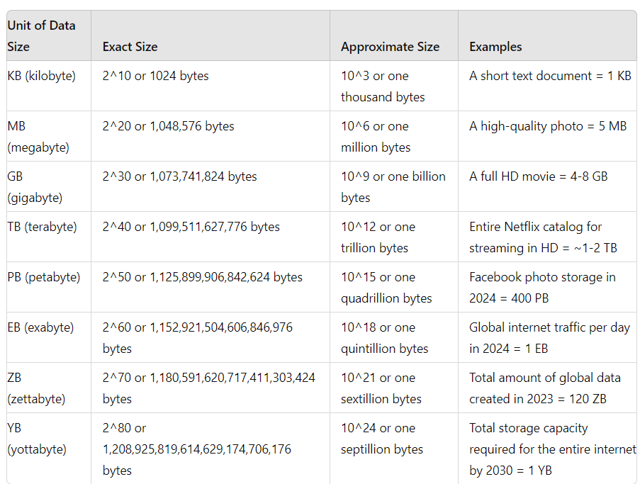
Data Sizes and Data Units

Slide 10
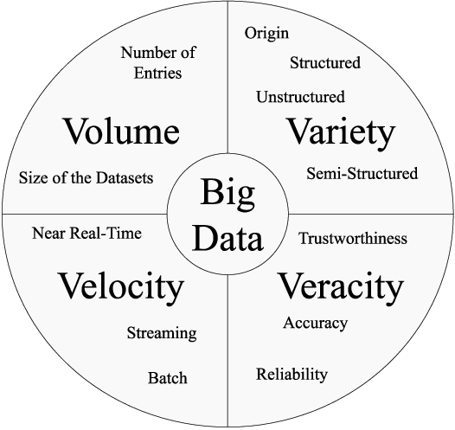
Characteristics of Big Data
Volume: The sheer size of data generated every second.
Velocity: The speed at which new data is generated and processed.
Variety: The different types of data.
Veracity: The accuracy and trustworthiness of the data.
Value: The potential insights and benefits that can be derived from data.

Slide 11
Volume
Definition: Refers to the massive amount of data generated.
Examples:
Social media posts, transaction records, sensor data.
Facebook generates approximately 4 petabytes of data per day.
Walmart handles over 1 million customer transactions every hour.
Implications:
Requires scalable storage solutions.
Necessitates advanced processing techniques to manage and analyze data efficiently.

Slide 12
Velocity
Definition: The speed at which data is generated and processed.
Examples:
Real-time data streams from Social Media, IoT devices, financial market data.
Twitter processes around 500 million tweets per day.
High-frequency trading algorithms in stock markets operate in milliseconds.
Implications:
Real-time data processing capabilities.
Need for technologies like Apache Kafka and Spark Streaming.

Slide 13
Variety
Definition: The different types of data.
Examples:
Structured: Relational databases, spreadsheets.
Semi-structured: XML, JSON.
Unstructured: Text documents, social media posts, multimedia files.
Implications:
Diverse data integration methods.
Techniques for processing and analyzing different data formats.

Slide 14
Veracity – دقة البيانات – موثوقية البيانات
Definition: The accuracy and reliability of data.
Examples:
Incomplete data entries.
Data from biased sources.
Implications:
Data cleaning and validation processes.
Importance of data governance and quality management.

Slide 15
Value
Definition: The potential benefits derived from analyzing data. Importance: Turning data into actionable insights to drive business decisions.
Examples:
Improved decision-making through data insights.
Enhanced customer experiences and personalization.
Implications:
Focus on extracting meaningful insights.
Leveraging data to drive business strategy and innovation.

Slide 16
Questions?
Can you think of examples of Big Data you encounter in daily life?

Slide 17
Historical Context Evolution of Data Processing and Storage

Slide 18
Content
Introduction to the evolution of data processing and storage.
Overview of key milestones and technological advancements.
Understanding how these changes impact current Big Data practices.

Slide 19


Early Data Processing (1950s - 1960s)
Mainframe Computers: The advent of mainframe computers for batch processing.
Examples:
IBM 701, UNIVAC.
Punch Cards: Used for data input and storage.
Limitations: Limited storage capacity, slow processing speeds.
Key Technologies:
Magnetic tapes for data storage.
Assembly language for programming.

Slide 20
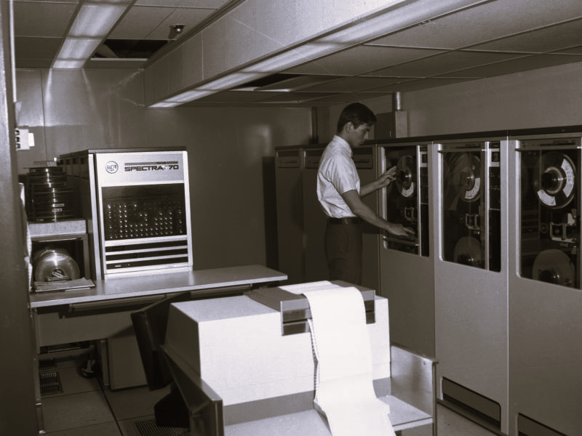
The Rise of Databases (1970s - 1980s)
Relational Databases: Introduction of relational database management systems (RDBMS).
Key Innovators: Edgar F. Codd, IBM System R.
SQL: Development of Structured Query Language (SQL) for data manipulation.
Data Storage Advancements:
Hard disk drives (HDD) replacing magnetic tapes.
Increased storage capacity and faster data retrieval.

Slide 21
Data Warehousing (1990s)
Data Warehousing Concept: Centralized repositories for integrating data from multiple sources.
Purpose: Analytical reporting and data analysis.
Key Innovations:
OLAP (Online Analytical Processing) for complex queries.
ETL (Extract, Transform, Load) processes for data integration.
Notable Technologies:
Teradata, Oracle Data Warehouse.

Slide 22
Emergence of Big Data (2000s)
Internet Explosion: Rapid growth of the internet, leading to massive data generation.
Examples: Social media, e-commerce, IoT devices.
Challenges: Traditional RDBMS struggled with the volume, velocity, and variety of data.
NoSQL Databases: Development of NoSQL databases to handle unstructured data.
Examples: MongoDB, Cassandra, HBase.

Slide 23
Hadoop and the Big Data Era (2006 - Present)
Apache Hadoop: Open-source framework for distributed storage and processing.
Components: HDFS (Hadoop Distributed File System), MapReduce.
Big Data Ecosystem: Growth of complementary technologies.
Examples: Apache Spark, Kafka, Flink...etc.
Cloud Computing: Emergence of cloud platforms for scalable storage and processing.
Providers: Amazon Web Services (AWS), Google Cloud, Microsoft Azure.

Slide 24
Modern Data Processing and Storage
Real-Time Data Processing: Technologies for real-time data ingestion and analysis.
Examples: Apache Storm, Spark Streaming.
Data Lakes: Centralized repositories for storing all types of data in their native format.
Benefits: Scalability, flexibility, and cost effectiveness.
Machine Learning Integration: Use of Big Data for training machine learning models.
Frameworks: TensorFlow, PyTorch.

Slide 25
Impact on Current Big Data Practices
Scalability: Ability to handle large-scale data processing with distributed systems.
Efficiency: Faster data processing with modern frameworks.
Flexibility: Support for diverse data types and real-time analytics.
Innovation: Continuous development of new tools and technologies to address emerging challenges.

Slide 26
Importance and Applications of Big Data

Slide 27
Content
Introduction to the significance of Big Data in modern industries.
Overview of key benefits and applications.
Exploring use cases in various sectors: finance, healthcare, retail, and more.

Slide 28
Importance of Big Data
Data-Driven Decision Making: Enables organizations to make informed decisions based on data insights.
Competitive Advantage: Helps companies gain a competitive edge by understanding market trends and customer behavior.
Innovation: Drives innovation through the discovery of new patterns and opportunities.
Operational Efficiency: Enhances operational processes by identifying inefficiencies and optimizing resources.
Personalization: Allows for personalized customer experiences by analyzing individual preferences and behaviors.

Slide 29
Big Data in Finance
Fraud Detection: Identifies unusual patterns and anomalies to detect fraudulent activities.
Example: JPMorgan Chase uses big data to detect fraud, saving the company millions of dollars annually.
Risk Management: Assesses and mitigates financial risks using predictive analytics.
Example: Morgan Stanley uses big data to manage risk in real-time, reducing potential losses.
Customer Analytics: Analyzes customer data to provide personalized financial products and services.
Example: Bank of America uses big data to offer personalized financial advice through its virtual assistant, Erica.
Algorithmic Trading: Uses big data to inform high-frequency trading algorithms.
Example: Goldman Sachs uses big data analytics to make split-second trading decisions, handling billions in trades daily.

Slide 30
Big Data in Healthcare
Predictive Analytics: Predicts disease outbreaks and patient outcomes using historical data.
Example: Kaiser Permanente uses predictive analytics to reduce hospital readmissions, saving over $1 billion annually.
Personalized Medicine: Tailors medical treatments to individual patients based on their genetic information and health data.
Example: The Cleveland Clinic uses big data to provide personalized treatment plans for cancer patients, improving survival rates.
Operational Efficiency: Optimizes hospital operations and resource management.
Example: Mount Sinai Medical Center uses big data to predict patient admissions and optimize staff scheduling, reducing wait times by 10%.
Medical Research: Analyzes large datasets to advance medical research and drug discovery.
Example: Pfizer uses big data to streamline clinical trials, reducing development time for new drugs.

Slide 31
Big Data in Retail
Customer Insights: Analyzes customer behavior to understand purchasing patterns and preferences.
Example: Amazon uses big data to recommend products, contributing to 35% of its annual sales.
Inventory Management: Optimizes inventory levels and supply chain processes.
Example: Walmart uses big data analytics to manage its supply chain, reducing stockouts by 16%.
Pricing Strategies: Develops dynamic pricing models based on market demand and competitor pricing.
Example: Macy’s uses big data to implement dynamic pricing, increasing revenue by 10%.
Sentiment Analysis: Monitors customer feedback and social media to gauge brand sentiment.
Example: Nike uses sentiment analysis to track brand perception and inform marketing strategies, leading to a 15% increase in customer satisfaction.

Slide 32
Big Data in Manufacturing
Predictive Maintenance: Predicts equipment failures and schedules maintenance to prevent downtime.
Example: General Electric uses predictive maintenance to reduce equipment downtime by 20%.
Quality Control: Monitors production processes to ensure product quality.
Example: Toyota uses big data to improve quality control, reducing defects by 30%.
Supply Chain Optimization: Enhances supply chain efficiency through data analytics.
Example: Procter & Gamble uses big data to optimize its supply chain, saving $1 billion annually.
Product Innovation: Drives innovation by analyzing market trends and customer feedback.
Example: 3M uses big data to accelerate product development, launching new products 20% faster.

Slide 33
Big Data in Transportation
Traffic Management: Analyzes traffic patterns to improve road safety and reduce congestion.
Example: The city of Los Angeles uses big data to optimize traffic light timing, reducing congestion by 10%.
Fleet Management: Optimizes routes and schedules for transportation fleets.
Example: UPS uses big data to optimize delivery routes, saving 10 million gallons of fuel annually.
Predictive Maintenance: Predicts vehicle maintenance needs to prevent breakdowns.
Example: Delta Airlines uses predictive maintenance to reduce flight delays due to mechanical issues by 15%.
Public Transportation: Enhances public transportation systems through data-driven insights.
Example: Transport for London uses big data to improve bus schedules and reduce waiting times by 12%.

Slide 34
Big Data in Energy
Smart Grids: Analyzes energy consumption patterns to optimize grid operations.
Example: Duke Energy uses big data to manage its smart grid, reducing outages by 25%.
Renewable Energy: Enhances the integration and management of renewable energy sources.
Example: Google uses big data to optimize its renewable energy projects, achieving 100% renewable energy for its operations.
Energy Efficiency: Identifies opportunities for energy savings in industrial and residential settings.
Example: Siemens uses big data to improve building energy management, reducing energy consumption by 20%.
Asset Management: Optimizes the maintenance and operation of energy assets.
Example: Shell uses big data to monitor and maintain its oil rigs, reducing maintenance costs by 10%.

